Slide 1
Using Compliance to Quarantine: Remove the Risk and Rebuild Clean
Galen Emery
Chef

Slide 2
Who is Galen “The Kid” Emery?
I work on ‘Fed Island’
DoD, Civilian, or Intelligence Community? Yes.
I help agencies understand how to build and structure their systems and culture to solve their velocity problems
Live in San Diego
Joined Chef in March 2014

Slide 3

Trust

Slide 4
Trust
How do we decide we trust a system? What does that mean?
Least Privilege
How do we enforce that trust?

Slide 5
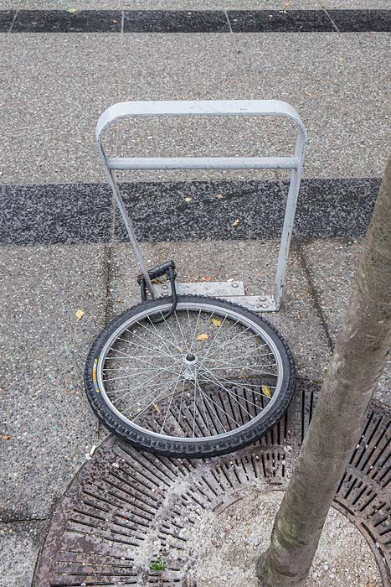
Trust – What does it mean if that trust is broken?

Slide 6
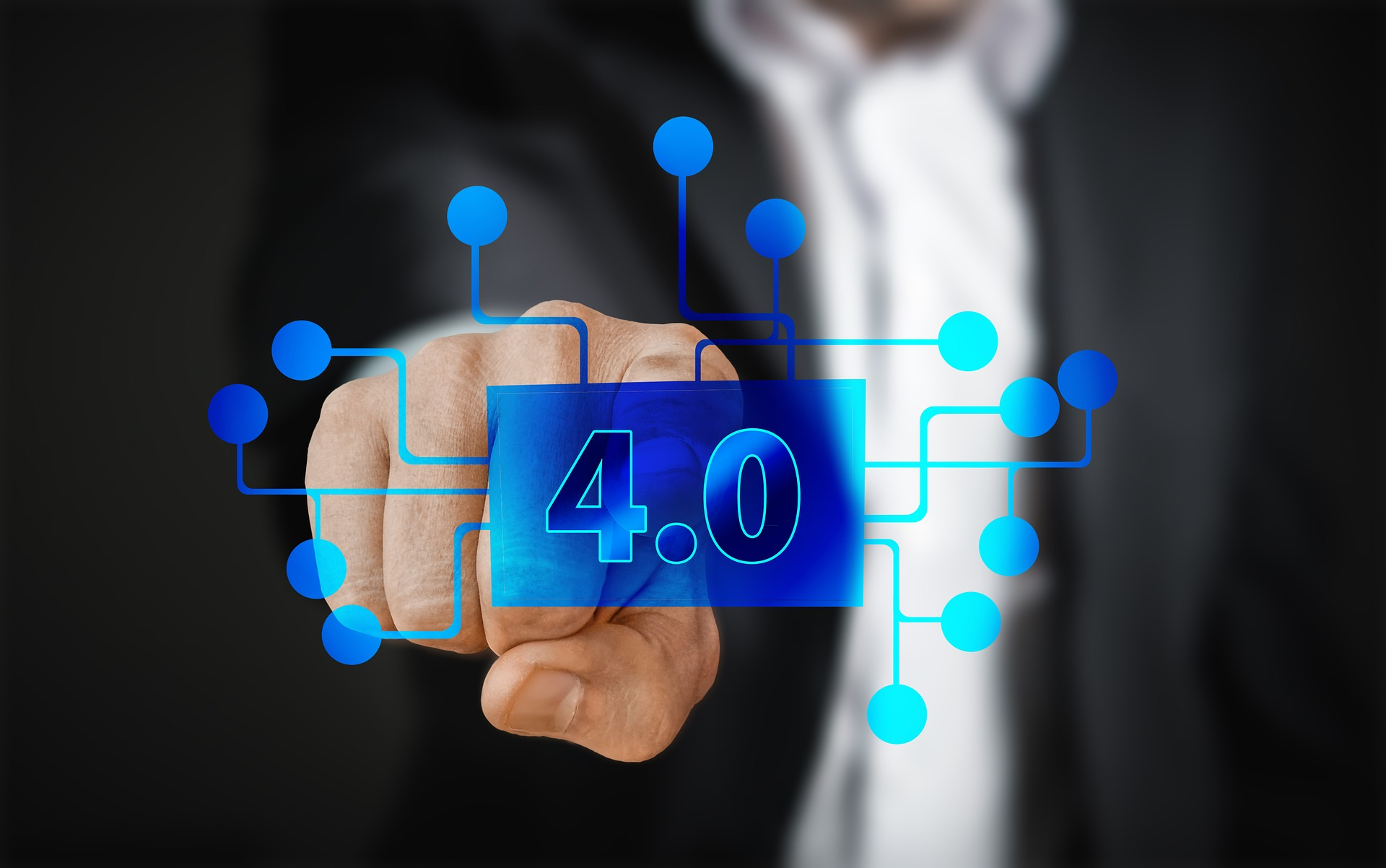
Automation

Slide 7
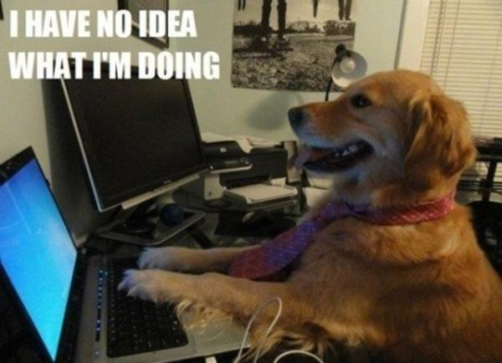
Automation – Engineers act on Code

Slide 8
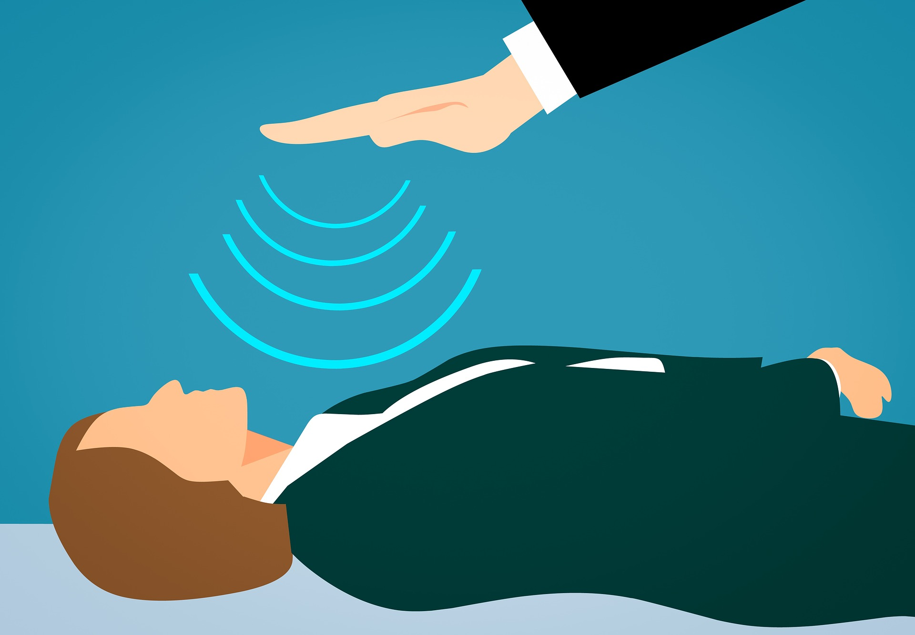
Automation – Self-Healing / Resilient

Slide 9
Demo

Slide 10
What else might I do in prod?
Re-launch everything that the ‘tainted’ system might have touched.
Rebuild prod in a new VPC
Disconnect real data and give attacker fake data
Voila! Insta(honey)pot!
Some of the theory is borrowed from Chaos Monkey, you must constantly test failure.

Slide 11

Save the date!
Week of May 20th

